Slide 1

Java Network
Dima Ionut Daniel

Slide 2
Contents
What is Java?
History
Basic Network Concepts
Streams
Internet Address
URI/URL
HTTP
Sockets
NIO
UDP
Conclusions
Bibliography

Slide 3

What is Java?
Java is a programming language created by Sun Microsystems.
Java is used in a wide variety of computing platforms from embedded devices and mobile phones on the low end, to enterprise servers and supercomputers on the high end.
Java eliminates certain low-level constructs such as pointers and has a very simple memory model where every object is allocated on the heap and all variables of object types are references.
Memory management is handled through integrated automatic garbage collection performed by the JVM.
The heart of the Java platform is the concept of a "virtual machine" that executes Java bytecode programs. This bytecode is the same no matter what hardware or operating system the program is running under.

Slide 4
What is Java? (cont.)
There is a JIT(Just-In-Time) compiler within the Java Virtual Machine, or JVM. The JIT compiler translates the Java bytecode into native processor instructions at run-time and caches the native code in memory during execution. The use of a JIT compiler means that Java applications, after a short delay during loading and once they have "warmed up" by being all or mostly JIT-compiled, tend to run about as fast as native programs.
The Java programs are cross-platform or platform independent, but the code of the Java Virtual Machines (JVM) that execute these programs is not.

Slide 5
History
JDK 1.0 - 23 january 1996
JDK 1.1 – 19 february 1997(AWT, JavaBeans, clase inner, JDBC)‏
J2SE 1.2 Playground – 8 december 1998(Reflexion, Collections, Java IDL, Swing, JIT Compiler)‏
J2SE 1.3 Kestrel – 8 may 1999(JNDI, JavaSound, JPDA, HotSpot JVM)‏
J2SE 1.4 Merlin – 6 february 2002(JAXP, Java Web Start, chaining exceptions, regular expressions)‏
J2SE 5.0 Tiger – 30 september 2004(for-each loop, generics, autoboxing, var-args, annotations, enum)‏
Java SE 6 Mustang – 11 december 2006(script support for JavaScript – Rhino engine,etc)‏
Java SE 7 Dolphin – final version september 2010

Slide 6
Basic Network Concepts
A network is a collection of computers/devices that can send/receive data.
Each machine on a network is called a node/host.
Every network node has an address that uniquely identifies it.
All modern computer networks are packet-switched network .
Data traveling on the network is broken into chunks called packets.
A protocol is a precise set of rules defining how computers communicates.

Slide 7
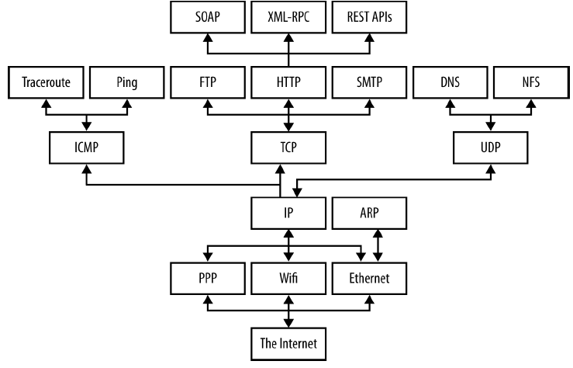
Basic Network Concepts (cont.)

Slide 8
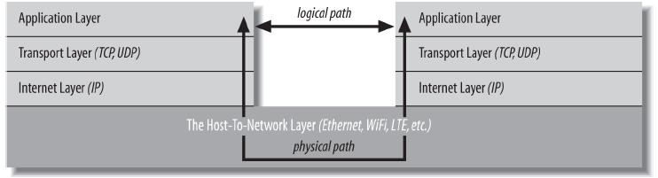
Basic Network Concepts (cont.)
The transport layer talks only to the application layer and the Internet layer.
The Internet layer in turn talks to the host-to-network layer and the transport layer.

Slide 9
Streams
Java's I/O libraries is designed in an abstract way that enables to read from external data sources and write to external targets. The java.io package contains classes that support input and output. The classes in the package are primarily stream-oriented;
A stream is an ordered sequence of bytes of indeterminate length. Input streams move bytes of data into a Java program from some generally external source. Output streams move bytes of data from Java to some generally external target.
The central classes in the package are InputStream and OutputStream which are abstract base classes for reading from and writing to byte streams, respectively.

Slide 10
Streams (cont.)
Input and output streams are fundamentally byte-based. Readers and writers are based on characters, which can have varying widths depending on the character set. ASCII and Latin-1 use 1-byte characters, UTF-32 uses 4-byte characters.
The related classes Reader and Writer are abstract base classes for reading from and writing to character streams, respectively.
The stream classes follow the decorator pattern by extending the base subclass to add features to the stream classes.
Almost every method that performs input or output is declared to throw an IOException or other IOException sublasses.

Slide 11
Streams (cont.)
The console is the default destination for output written to System.out or System.err and the default source of input for System.in. On Unix systems the console refers to a very specific command-line shell rather than to command-line shells overall.
System.out is the first instance of the OutputStream class most programmers are using.
It's an instance of java.io.PrintStream, a subclass of java.io.OutputStream. Output sent to System.out appears on the console.
System.err is most commonly used inside the catch clause of a try/catch block when errors are logged.
System.in is the input stream connected to the console.

Slide 12
Streams (cont.)
Java 6 added a singleton new java.lang.Console class that provides a few convenience methods for input and output. Example: Console theConsole = System.console( );
Java 5 added a Closeable interface that many io classes are implementing. A Closeable is a source or destination of data that can be closed. The close method is invoked to release resources that the object is holding (such as open files).
Many output streams buffer writes to improve performance. Rather than sending each byte to its destination as it's written, the bytes are accumulated in a memory buffer ranging in size from several bytes to several thousand bytes. When the buffer fills up, all the data is sent at once.
The flush( ) method forces the data to be written whether or not the buffer is full.
Java 5 added a Flushable interface, having the flush method that is implemented by io classes.

Slide 13
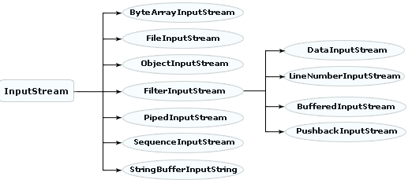
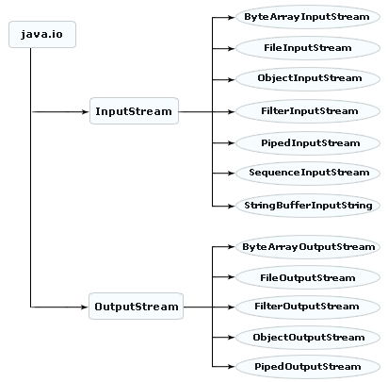
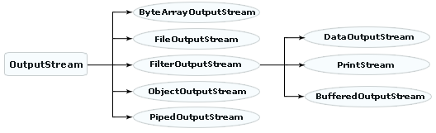
Streams (cont.)

Slide 14
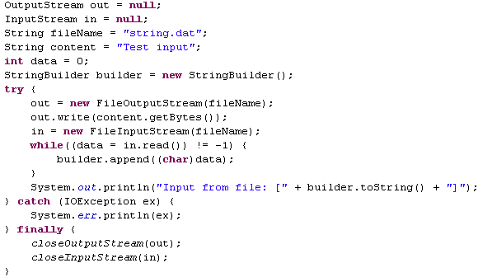
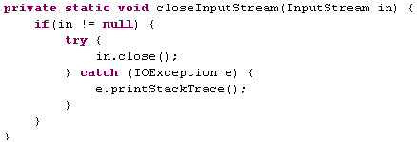
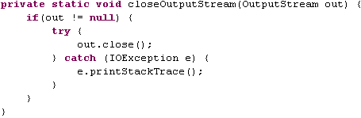
Streams (cont.)

Slide 15
Streams (cont.)
The java.io.FileInputStream and java.io.FileOutputStream classes provide methods for reading and writing data in files.They don't provide is file management, like finding out whether a file is readable or writable or moving a file from one directory to another.
FileInputStream is a concrete class and provides an input stream connected to a particular file.Methods most used: read( ), available( ), skip( ), and close( ). The FileInputStream class has one method that's not declared in the InputStream superclass: getFD( ), returning a FileDescriptor class.
The java.io.FileOutputStream class provides output streams connected to files. Methods commonly used write( ), flush( ), and close( ). Also FileOutputStream can return a FileDescriptor object calling getFD().

Slide 16
Streams (cont.)
On network programming we use sockets.The socket provides a reliable connection for the transmission of data between two hosts. It isolates you from the details of packet encodings, lost and retransmitted packets, and packets that arrive out of order. A socket performs four fundamental operations:
Connects to a remote machine
Sends data
Receives data
Closes the connection
A socket may both send data to and receive data from the remote host it's connected to. The java.net.Socket class is Java's interface to a network socket and allows you to perform all four fundamental socket operations.
Data is sent across the socket via streams. These are the methods to get both streams for the socket: getInputStream(), getOutputStream().

Slide 17
Streams (cont.)
The java.io package provides a set of abstract classes that define and partially implement filter streams.
A filter stream filters data as it's being read from or written to the stream. The filter streams are FilterInputStream and FilterOutputStream.
Common filter streams classes: DataInputStream,DataOutputStream, BufferedInputStream, BufferedOutputStream, PrintStream.
The java.util.security package contains the DigestInputStream and DigestOutputStream filter streams.
The Java Cryptography Extension (JCE) adds two more filter streams to this package, CipherInputStream and CipherOutputStream, which can encrypt or decrypt data using a variety of algorithms.

Slide 18
Streams (cont.)
PrintStream is a filter stream and thus can be connected to any other output stream: FileOutputStream, ByteArrayOutputStream, TelnetOutputStream.
The println( ) method always adds a line break at the end of each line it prints. The line break character varies from platform to platform.
PrintStream methods never throw IOExceptions. Each method in the class catches IOException. When an exception occurs, an internal flag is set to true. We can test this flag using the checkError() method.
There's also a protected setError() method we can use to signal an error from a subclass. Once an error has been set, there's no way to unset it.

Slide 19
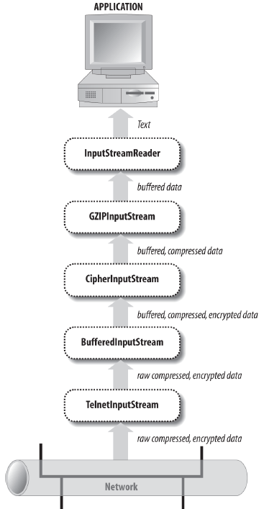
Streams (cont.)

Slide 20
Streams (cont.)
Data streams read and write strings, integers, floating-point numbers, and other data at a higher level than bytes. The java.io.DataInputStream and java.io.DataOutputStream classes read and write the primitive Java data types and strings in a particular, platform-independent format.
The java.io.DataInput interface declares 15 methods for reading various data: readBoolean, readByte, readUnsignedByte, readShort, readUnsignedShort, readChar, readInt, readLong, readFloat, readDouble, readLine,readUTF.
The java.io.DataOutput interface declares 14 methods, complementary to those in DataInput: write, writeBoolean, writeByte, writeShort, writeChar, writeInt, writeLong, writeFloat, writeDouble, writeBytes, writeChars, writeUTF.

Slide 21
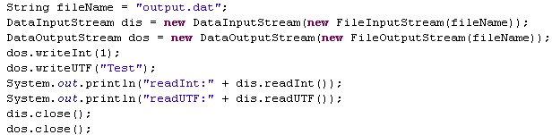
Streams (cont.)
The DataInputStream class also has a commonly used but deprecated readLine() .

Slide 22
Streams (cont.)
The java.io.Writer class is modeled on the java.io.OutputStream class and java.io.Reader after java.io.InputStream. The difference between readers and writers and input and output streams is that streams are fundamentally byte-based while readers and writers are fundamentally character-based.
While bytes are a more or less universal concept, characters are not. Characters can even have different sizes in different character sets. For example, ASCII and Latin-1 use 1-byte characters. UTF-8 uses characters of varying width between one and four bytes.

Slide 23
Streams (cont.)
A language that supports international text must separate the reading and writing of raw bytes from the reading and writing of characters. Classes that write characters must be able to translate the language's native character set into a variety of formats and write those. This task is performed by the InputStreamReader and OutputStreamWriter classes.
Input and output can be time-consuming operations. It's often quicker to read or write text in large chunks rather than in many separate smaller pieces, even when you only process the text in the smaller pieces.
The java.io.BufferedReader and java.io.BufferedWriter classes provide internal character buffers.

Slide 24
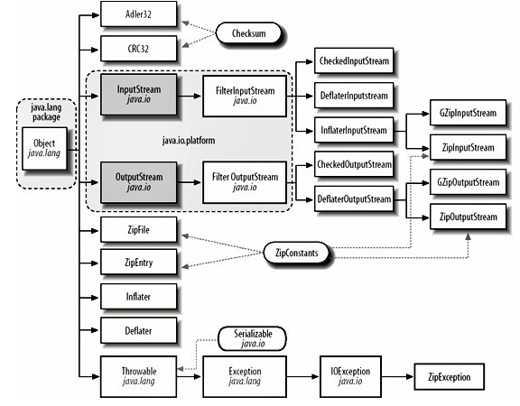
Streams (cont.)
The java.util.zip package contains six stream classes and another half dozen assorted classes that read and write data in zip, gzip, and inflate/deflate formats. Java uses these classes to read and write JAR archives and to display PNG images.

Slide 25
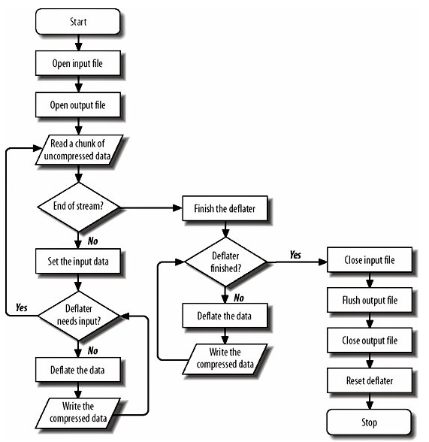
Streams (cont.)
The Inflater and Deflater classes are raw classes.
It would be more easy to write uncompressed data onto an output stream and have the stream compress, without worrying about the mechanics of deflation.
Similarly, it would be useful to have an input stream class that could read from a compressed file and return the uncompressed data.
The java.util.zip.DeflaterOutputStream class is a filter stream that compresses the data
The java.util.zip.InflaterInputStream class inflates deflated data before passing it to the reading program.
The java.util.zip.GZIPInputStream and java.util.zip.GZIPOutputStream classes do the same thing except using the gzip format

Slide 26
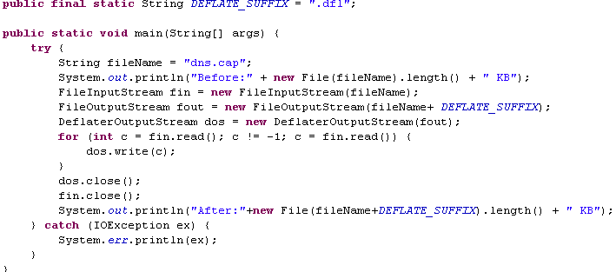

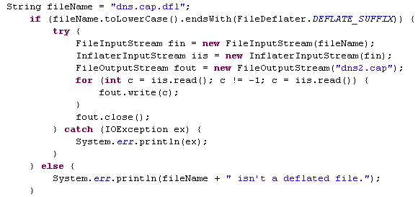
Streams (cont.)

Slide 27
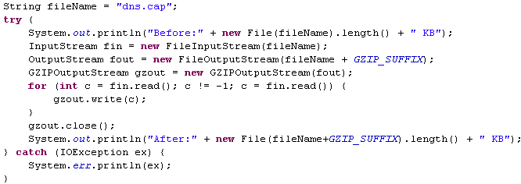

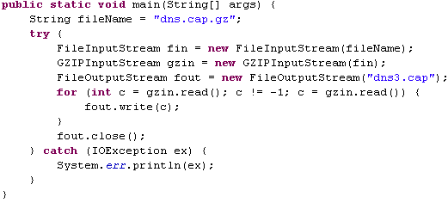
Streams (cont.)

Slide 28
Streams (cont.)
Gzip and deflate are compression formats.
Zip is both a compression and an archive format.
A single zip file may contain more than one uncompressed file, along with information about the names, permissions, creation and modification dates, and other information about each file in the archive.
The java.util.zip.ZipFile class represents a file in the zip format. Such file might be created by many other zip programs.
The java.util.zip.ZipEntry class represents a single file stored in such an archive.
A ZipEntry object contains extra information : name, comment, modification time, CRC checksum, size, compressed size, method. Common methods: getName, getTime, getSize, getCompressedSize, getCrc, getMethod, getExtra, getComment, isDirectory

Slide 29
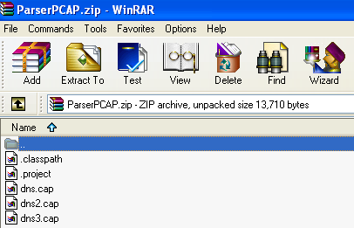
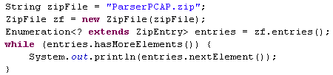

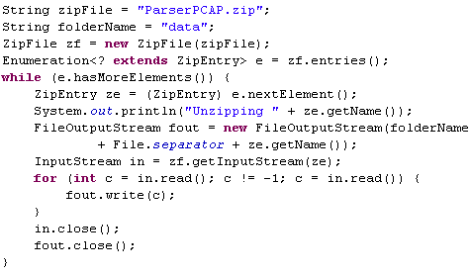

Streams (cont.)

Slide 30
Streams (cont.)
Compressed files are especially susceptible to corruption. Is common practice store a checksum with the compressed file so that the recipient can verify that the file is intact.
The zip format does this automatically, but we can use manual checksums in other circumstances.
The java.util.zip.Checksum interface is calculating a checksum for a sequence of bytes. Common methods: update, getValue, reset.
The update() methods calculate the initial checksum and update the checksum as more bytes are added to the sequence. As bytes increase, the checksum changes.
The getValue() method returns the current value of the checksum.
The reset() method returns the checksum to its initial value.
The java.util.zip package provides two concrete implementations of the Checksum interface, CRC32 and Adler32. Both produce 32-bit checksums.
The java.util.zip.CheckedInputStream and java.util.zip.CheckedOutputStream classes keep a checksum of the data they've read or written.

Slide 31
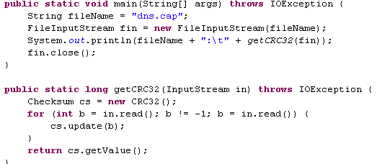
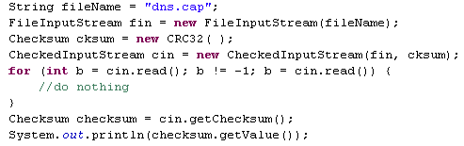


Streams (cont.)

Slide 32
Streams (cont.)
JAR archives are the standard means of packaging and distributing Java software. The content in a JAR archive can be found by the class loader as long as it is somewhere in the classpath.
JAR files also improve performance, especially in applications such as applets and Java Web Start-launched applications that download their code from a server. The content in the JAR archive is compressed.
Storing resources in a JAR file makes your applications faster, more robust, harder to accidentally break, and easier to install. The JAR file is treated like a directory in the context of the classpath.
The manifest file, which provides meta-information about the contents of the archive in a particular format, is named MANIFEST.MF and is stored in the META-INF directory at the top of the archive.The manifest is added as part of the archiving process.

Slide 33
Streams (cont.)
At a minimum, a manifest file must contain this opening line: "Manifest-Version: 1.0".
A manifest usually contains additional entries for some of the files in the archive. Each entry is composed of a list of name/value pairs, one to a line. Names are separated from values by colons and whitespace.
The java.util.jar.JarFile class represents a file in the JAR format. The java.util.jar.Manifest class represents this manifest file.
JarInputStream is a subclass of ZipInputStream that reads data from JAR archives.
JarOutputStream is a subclass of ZipOutputStream.
One of the simplest ways to get information from a JAR file is through the java.net.JarURLConnection class and represents an active connection to a JAR file, generally via either the HTTP or file protocols.

Slide 34
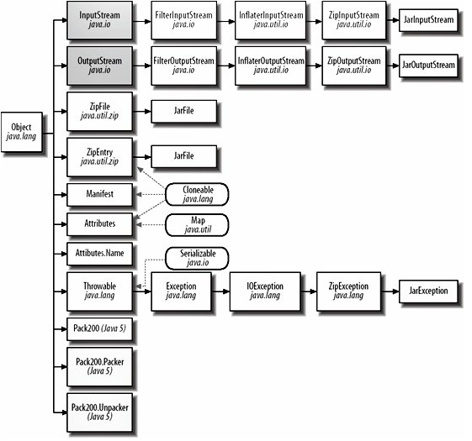
Streams (cont.)

Slide 35
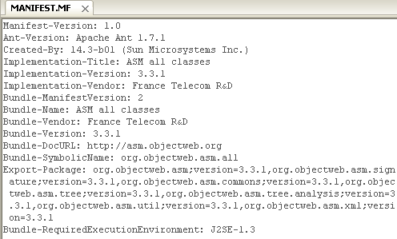
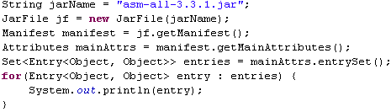
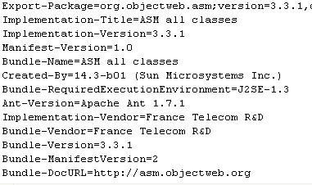
Streams (cont.)

Slide 36
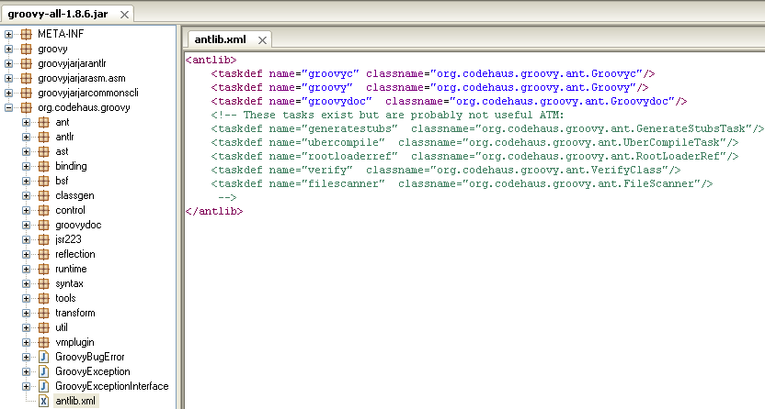
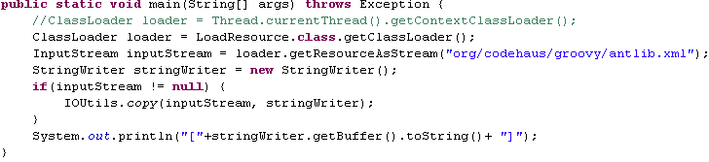
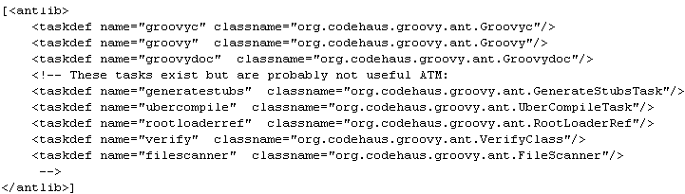
Streams (cont.)
Having groovy-all-1.8.6.jar in the classpath we can extract certain resource from the jar file as InputStream for later processing, using the getResourceAsStream method from the ClassLoader instance.

Slide 37
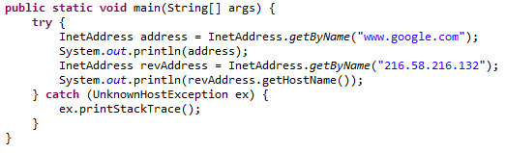
Internet Addresses
Devices connected to the Internet are called nodes.
Nodes that are computers are called hosts.
Each node or host is identified by an Internet address or an IP address.
The java.net.InetAddress class is Java’s high-level representation of an IP address.
It is used by most of the other networking classes, including Socket,ServerSocket, URL, DatagramSocket,

Slide 38
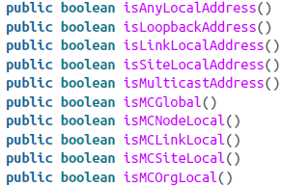
Internet Addresses (cont.)
Some IP addresses and some patterns of addresses have special meanings..
The 127.0.0.1 is the local loopback address.
IPv4 addresses in the range 224.0.0.0 to 239.255.255.255 are multicast addresses.
Java includes methods for testing whether an InetAddress object meets any of these criteria:
Java uses two classes, Inet4Address and Inet6Address, in order to distinguish IPv4 addresses from IPv6 addresses.
The NetworkInterface class represents a local IP address. This can either be a physical interface such as an additional Ethernet card or it can be a virtual interface bound to the same physical hardware as the machine’s other IP addresses.

Slide 39

URI/URL
HTML is a hypertext markup language because it includes a way to specify links to other documents identified by URLs.
URL is the most common type of URI(Uniform Resource Identifier).
The syntax of a URI is composed of a scheme and a scheme-specific part(ex: scheme:scheme-specific-part).
The URL class is the simplest way for a Java program to locate and retrieve data from the network.
The URL class has several methods that retrieve data from a URL:

Slide 40
URI/URL (cont.)
URLs are composed of five pieces:
The scheme, also known as the protocol
The authority
The path
The fragment identifier, also known as the section or ref
The query string
Read-only access to these parts of a URL is provided by nine public methods: getFile(), getHost(), getPort(), getProtocol(), getRef(), getQuery(), getPath(),getUserInfo(), and getAuthority().

Slide 41
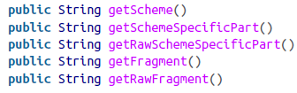
URI/URL (cont.)
A URI reference has up to three parts: a scheme, a scheme-specific part, and a fragment identifier(ex: scheme:scheme-specific-part:fragment).
A URI is a generalization of a URL that includes not only Uniform Resource Locators but also Uniform Resource Names (URNs).
The URI class has getter methods that return these three parts of each URI object.
These methods all return null if the particular URI object does not have the relevant component.
A URI that has a scheme is an absolute URI. A URI without a scheme is relative.

Slide 42
URI/URL (cont.)
The Proxy class allows more fine-grained control of proxy servers from within a Java program.
There are still only three kinds of proxies, HTTP, SOCKS, and direct connections represented by three constants in the Proxy.Type enum.
Each running virtual machine has a single java.net.ProxySelector object it uses to locate the proxy server for different connections.

Slide 43
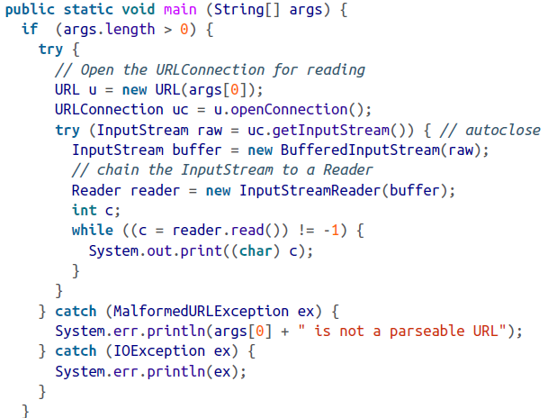
URI/URL (cont.)
URLConnection is an abstract class that represents an active connection to a resource specified by a URL.
provides access to the HTTP header.
can configure the request parameters sent to the server.
can write data to the server as well as read data from the server.

Slide 44
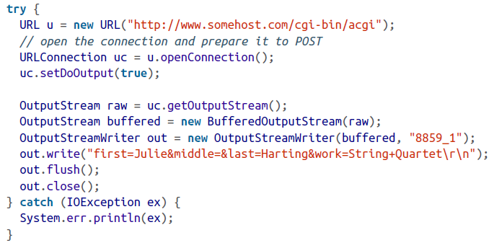
URI/URL (cont.)
A URLConnection doesn’t allow output by default, so setDoOutput(true) needs to be called first.
When you set doOutput to true for an http URL, the request method is changed from GET to POST.

Slide 45
HTTP
The Hypertext Transfer Protocol(HTTP) is the standard protocol for communication between web browsers and web servers.
HTTP connections use the TCP/IP protocol for data transfer.
Each request and response has the same basic form: a header line, an HTTP header containing metadata, a blank line, and then a message body.
Many websites use small strings of text known as cookies to store persistent client-side state between connections.
Cookies are passed from server to client and back again in the HTTP headers of requests and responses.
Java 5 includes an abstract java.net.CookieHandler class that defines an API for storing and retrieving cookies.

Slide 46

HTTP (cont.)
The java.net.HttpURLConnection class is an abstract subclass of URLConnection.
It provides some additional methods that are helpful when working specifically with http URLs.
The HttpURLConnection class transparently supports HTTP Keep-Alive unless you explicitly turn it off.
It will reuse sockets if you connect to the same server again before the server has closed the connection.
disconnect() method enables a client to break the connection.

Slide 47
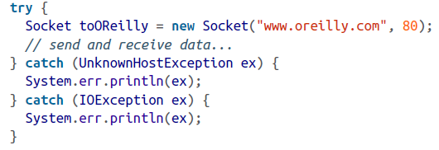
Sockets
A socket is a connection between two hosts. It can perform seven basic operations:
Connect to a remote machine
Send data
Receive data
Close a connection
Bind to a port
Listen for incoming data
Accept connections from remote machines on the bound port
Java’s Socket class, which is used by both clients and servers.

Slide 48
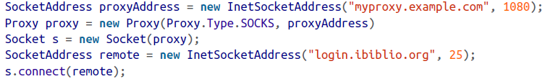

Sockets (cont.)
We can create sockets and use proxies.
We can retrieve information from sockets like:
Remote address
Remote port
Local address
Local port

Slide 49
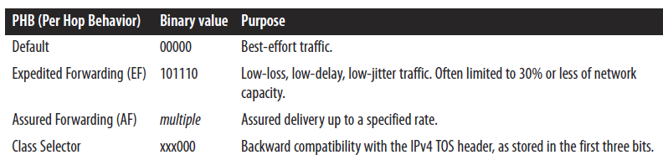
Sockets (cont.)
Java supports 9 options for client-side sockets:
TCP_NODELAY → ensures that packets are sent as quickly as possible regardless of their size.
SO_BINDADDR → reuse local address and not release it.
SO_TIMEOUT →how much time to wait before reading is perfomed.
SO_LINGER → specifies what to do with datagrams that have not yet been sent when a socket is closed.
SO_SNDBUF → send buffer size
SO_RCVBUF → receive buffer size
SO_KEEPALIVE → if turned on, the client occasionally sends a data packet over an idle connection.
OOBINLINE → sends a single byte of “urgent” data out of band.
IP_TOS → different types of Internet service have different performance needs.

Slide 50
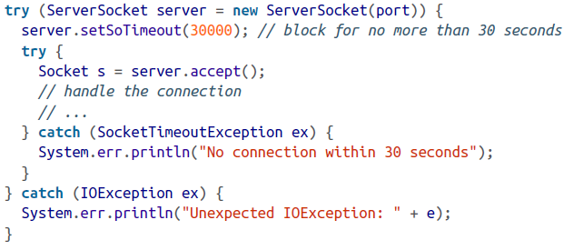
Sockets (cont.)
In order to create a server ServerSocket is used.

Slide 51
NIO
Java 1.4 introduced a new model for I/O.
The package java.nio (NIO or New I/O) was added to support memory-mapped I/O, facilitating I/O operations closer to the underlying hardware with sometimes dramatically better performance.
The subpackage java.nio.charset provides support for different character encodings for character data.
The subpackage java.nio.channels provides support for channels, which represent connections to entities that are capable of performing I/O operations, such as files and sockets. The java.nio.channels package also provides support for fine-grained locking of files.
Whereas the traditional I/O model is based on streams, the new I/O model is based on buffers and channels.

Slide 52
NIO (cont.)
A buffer holds the data to be read and written and can be used for both reading and writing.
java.nio has seven basic buffer classes for the seven different primitive data types: ByteBuffer, ShortBuffer, IntBuffer, CharBuffer, FloatBuffer, DoubleBuffer, LongBuffer.
You create new buffers primarily in two ways: by allocation and by wrapping.
Allocation creates a new buffer backed by memory, whereas wrapping uses a buffer as an interface to an existing array.
Eg: ByteBuffer bBuffer = ByteBuffer.allocate(1024);
Eg: int[] data = {9, 4,7}; IntBuffer buffer = IntBuffer.wrap(data);
In both cases, the arrays are not copies. These are the actual internal arrays where the buffer holds its data. Changing the data in these arrays changes the buffer's contents too, and vice versa.

Slide 53
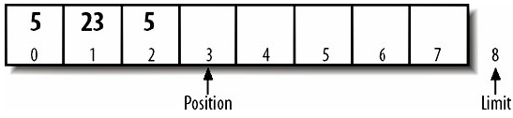
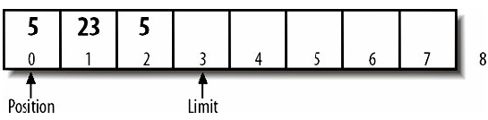
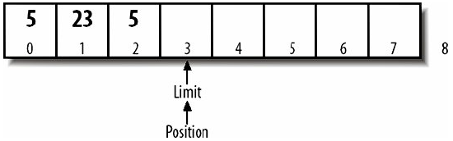
NIO (cont.)
We can allocate an array directly using the allocateDirect().
Eg: ByteBuffer directBuffer = ByteBuffer.allocateDirect(1024);
A lot of I/O operations may be performed directly on the files without copying them to RAM first.
Common buffer methods: limit, position, flip, hasRemaining, get, put.
The flip() method sets the limit to the current position and then sets the position to 0.
The hasRemaining() method returns true as long as the position is less than the limit.
buffer.flip()
while (buffer.hasRemaining()) buffer.get( );

Slide 54
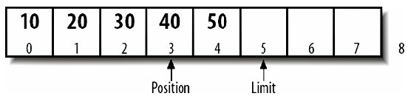
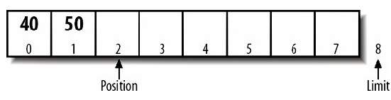
NIO (cont.)
For both put and get, the array must fit into the available space.
If we put a larger array into the buffer than it has space left for, put() throws BufferOverflowException.
If we get a larger array than the buffer has data remaining, get() throws BufferUnderflowException.
Buffers are often used for sequential reading and writing. Compacting removes all the data from the buffer before the current position, then shifts the remaining data backwards in the buffer to the beginning.
buffer.compact()

Slide 55
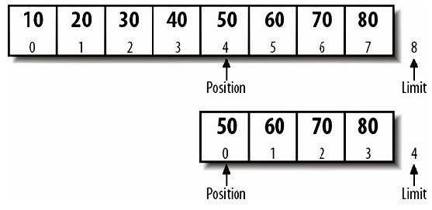
NIO (cont.)
The duplicate method is a new buffer object that has the same internal data as the original buffer, but an independent mark, limit, and position. A duplicate is not a copy or a clone. Duplicates are useful when you want the same content to be processed simultaneously or independently.
The slice method is similar to a duplicate but includes only a subsequence.
buffer.slice()

Slide 56
NIO (cont.)
Buffers can be read-only. Buffers might also be read-only if they're memory mapped to a file you don't have write permission for, or to the input buffer on a network card.
Any attempt to store data into a read-only buffer will throw a runtime exception ReadOnlyBufferException. Usefull methods: isReadOnly(), asReadOnlyBuffer().
The MappedByteBuffer class maps a file directly into a ByteBuffer. However, the puts and gets access the file directly without copying a lot of data to and from RAM. Mapped byte buffers are created using the map( ) method in the FileChannel class.

Slide 57
NIO (cont.)
Memory mapping can operate in three modes: READ_ONLY, READ_WRITE, PRIVATE.
FileChannel.MapMode.READ_ONLY → we can get data from the buffer but cannot change the data in the buffer.
FileChannel.MapMode.READ_WRITE → we can both get data from and put data in the buffer.
FileChannel.MapMode.PRIVATE → we can get data from and put data in the buffer, but the data you put is visible only through this buffer. The file itself is not changed.
Eg: RandomAccessFile file = new RandomAccessFile("file.txt", "rw");
FileChannel channel = file.getChannel( );
ByteBuffer buffer = channel.map(FileChannel.MapMode.READ_WRITE, 0, file.length( ));

Slide 58
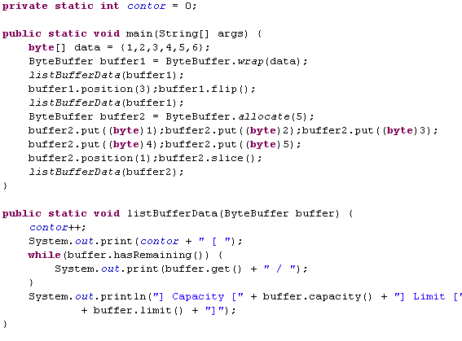

NIO (cont.)

Slide 59
NIO (cont.)
The superinterface for channels is java.nio.channels.Channel, having 2 methods: isOpen() and close().
The ReadableByteChannel and WritableByteChannel interfaces are used for channels that read and write bytes.
ReadableByteChannel declares a single method read() that fills a ByteBuffer with data read from the channel.
WritableByteChannel declares a single method write() that writes ByteBuffer to the channel.
Channels that can both read and write sometimes implement the ByteChannel interface. This interface is implemented by SocketChannel, DatagramChannel, and FileChannel.
The read() and write() methods are declared to throw IOException.

Slide 60
NIO (cont.)
We cannot write to or read from a closed channel or ClosedChannelException will be thrown.
If the channel is closed by another thread while the write or read is in progress AsynchronousCloseException is thrown.
If another thread interrupts the thread's read or write operation ClosedByInterruptException is thrown.
The read() and write() methods can also throw runtime exceptions: NonReadableChannelException , NonWritableChannelException.
The InterruptibleChannel interface is a marker that, when implemented by a channel, indicates that the channel is interruptible.

Slide 61
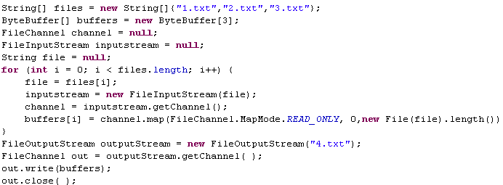
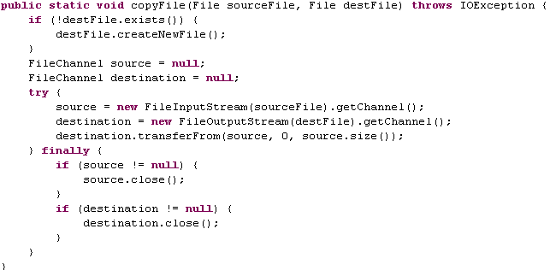
NIO (cont.)
The left example will concatenate the contents of the 3 files into one file named 4.txt.
The left example will copy the file from the source to the destination.

Slide 62
NIO (cont.)
A java.nio.channels.FileChannel can potentially be both a GatheringByteChannel and a ScatteringByteChannel. Each actual FileChannel object is either readable or writable, not both.
FileChannels created by invoking the getChannel() method of a FileOutputStream are writable.
FileChannels created by invoking the getChannel() method of a FileInputStream are readable.
Invoking a write() method on a channel connected to a FileInputStream throws NonWritableChannelException.
Invoking a read() method on a channel connected to a FileOutputStream throws NonReadableChannelException.
Specific operations:
Data can be transferred from the file to a channel, or from a channel to the file easy.
File channels can be locked so that other processes cannot access them.
File channels can be flushed to write data to an associated device.
The current position in the file can be changed and we don't have to read or write a file from beginning to end. We can jump around in the file.

Slide 63
NIO (cont.)
Unlike streams, file channels are safe for access from multiple concurrent threads. Multiple threads can read from or write to the same FileChannel simultaneously. Applications sometimes need exclusive access to particular files.
The lock() method creates a java.nio.channels.FileLock objects and locks the object. This method blocks until it can get the lock on the file.
FileLockInterruptionException is thrown if another thread interrupts the thread that is waiting for the lock.
For some use cases, it's not necessary to lock the entire file and we can lock a portion of the source.
public abstract FileLock lock(long position, long size, boolean shared).

Slide 64
NIO (cont.)
Channels serve as conduits to I/O services. I/O falls into two categories: file I/O and stream I/O, so there are two types of channels: file and socket → FileChannel class and three socket channel classes: SocketChannel, ServerSocketChannel, and DatagramChannel.
SocketChannel implements both ScatteringByteChannel and GatheringByteChannel.
There are differences between files and sockets:
Sockets must be explicitly connected.
Sockets can be disconnected.
Sockets can be selected.
Sockets support non-blocking I/O.

Slide 65
NIO (cont.)
Eg:
SocketAddress remote = new InetSocketAddress(host, port);
SocketChannel channel = SocketChannel.open(remote);
One server thread using a ServerSocketChannel can manage many different clients because is using non-blocking I/O features.
Eg:
ServerSocketChannel channel = ServerSocketChannel.open();
SocketAddress port = new InetSocketAddress(8080);
channel.socket().bind(port);

Slide 66
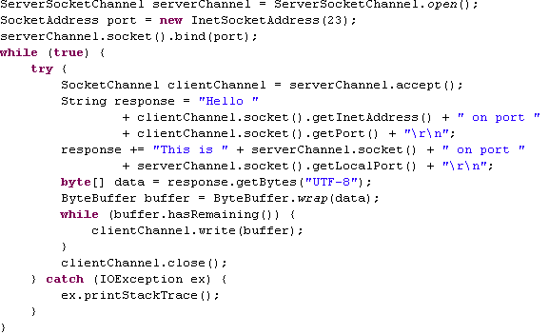
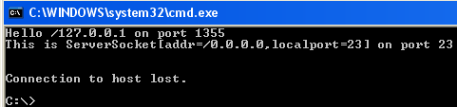
NIO (cont.)
The program will create a server that is listening on port 23 for telnet clients.
One the client is connected is returned certain information and then is disconnected

Slide 67
NIO (cont.)
Non-blocking I/O is one of the most important features of the new I/O API. Traditional stream-based I/O is limited by the speed of whatever it is you're reading or writing: the disk, the network, etc.
The traditional approach to this multiple clients is to place each connection in a separate thread.
One hundred simultaneous connections require one hundred threads. It takes time to set up and tear down each thread and each uses a finite quantity of system resources.
In non-blocking I/O, one thread can manage many different connections. Rather than fully processing each one in turn, the thread asks the channels which one is ready to be read or written without blocking.
Non-blocking I/O is primarily relevant to network connections. Pipe channels that move data between two threads also support non-blocking I/O. File channels don't support it.

Slide 68
NIO (cont.)
Using channels instead of streams we can implement using one thread and support many clients.
open a ServerSocketChannel.
set channel in nonblocking mode.
open Selector.
register the ServerSocketChannel with the Selector for accept operations.
When we register each channel with the Selector, we specify the kinds of operations for which you're registering:
SelectionKey.ACCEPT → accept connection from client.
SelectionKey.CONNECT → connection to a server.
SelectionKey.READ → read data from channel.
SelectionKey.WRITE → write data to channel.

Slide 69
NIO (cont.)
Using channels instead of streams we can implement using one thread and support many clients.
open a ServerSocketChannel.
set channel in nonblocking mode.
open Selector.
register the ServerSocketChannel with the Selector for accept operations.
When we register each channel with the Selector, we specify the kinds of operations for which you're registering:
SelectionKey.ACCEPT → accept connection from client.
SelectionKey.CONNECT → connection to a server.
SelectionKey.READ → read data from channel.
SelectionKey.WRITE → write data to channel.

Slide 70
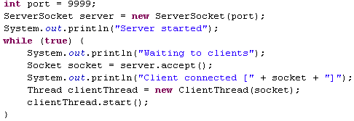

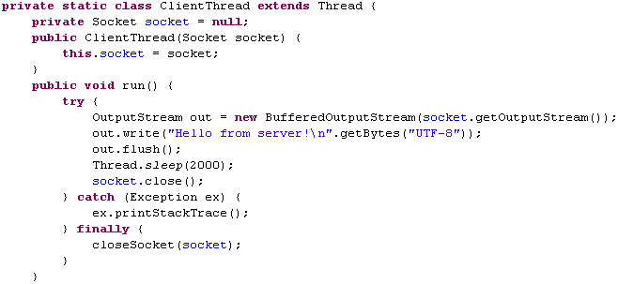

NIO (cont.)
The application will listen on port 9999 for network clients. After the client is connected a ClientThread will be created for later processing. Currently the client will receive a simple test message: “Hello from server!\n”.

Slide 71

NIO (cont.)

Slide 72
NIO (cont.)
By default, channels (and streams) block. Not all channels support nonblocking I/O. Network channels do, but file channels don't.
Those channels that do support non-blocking I/O are all subclasses of the java.nio.channels.SelectableChannel class.
All channels are created in blocking mode. and to switch a channel to non-blocking mode we call the configureBlocking(false) method.
Both register() methods returns a SelectionKey object that represents the unique connection between this channel and this Selector.
The java.nio.channels.Selector class is the crucial component of non-blocking I/O.

Slide 73
NIO (cont.)
We ask the Selector which of its channels are ready with: selectNow(), select(), select(timeout).
The selectNow() method is non-blocking, whereas the other two methods block.
After we've called one of these methods, the selectedKeys() method returns a java.util.Set containing keys for all the ready channels registered with this Selector.
Selectors may use native system resources and we should use close() method in the end.
The java.nio.channels.SelectionKey class encapsulates the information about a channel registered with a Selector. The SelectionKey object holds information like: channel, Selector, object attachment.
To read or write (or accept or connect) we need the channel from its key using the channel() method:
Eg:
SocketChannel client = (SocketChannel) key.channel( );
We can deregister a Selector from a channel by calling the cancel( ) method.

Slide 74
UDP
The User Datagram Protocol (UDP) is an alternative transport layer protocol for sending data over IP that is very quick, but not reliable.
Java’s implementation of UDP is split into two classes:
DatagramPacket
DatagramSocket
The DatagramPacket class encapsulates UDP packets called datagrams.
A DatagramSocket sends/receives UDP datagrams.

Slide 75

UDP (cont.)
The structure ot the UDP Datagram

Slide 76


UDP (cont.)

Slide 77

UDP (cont.)

Slide 78

Bibliography
OReilly Java Network Programming 4th
O'Reilly – Java I/O, 2nd Edition
O'Reilly – Java NIO

